Slide 1
CHALLENGE-1 STEVE’S CAR SHOWROOM
SQL CASE STUDY
BY – SUSHREE SANGEETA JENA

Slide 2
CONTENT
Problem Statement
Dataset
Solutions
Terms Used

Slide 3
Problem statement
The data analyst for Steve’s Car Showroom has abruptly quit, hence, left the company without crucial insights from the datasets.
So, we have to analyse the data and present crucial insights.
Link: https://steeldata.org.uk/sql1.html

Slide 4
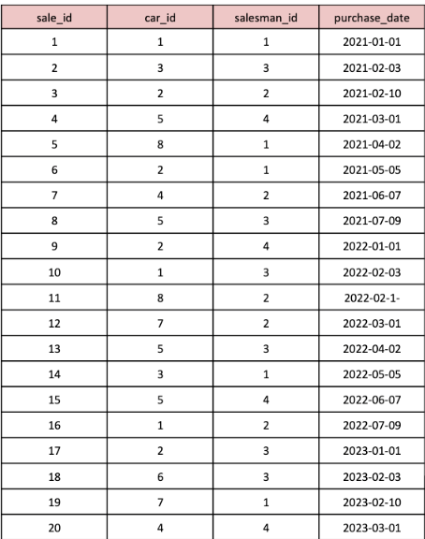
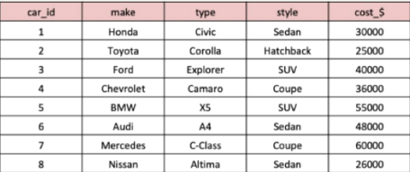
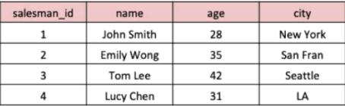
DATASETS
Sales:
Cars:
Salespersons:

Slide 5
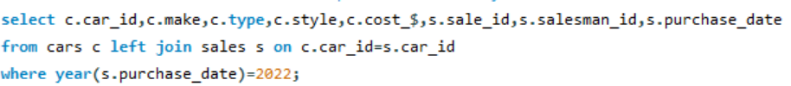
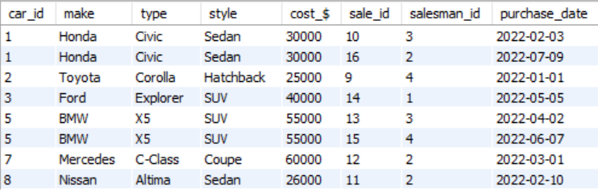
SOLUTIONS
1. What are the details of all cars purchased in the year 2022?

Slide 6

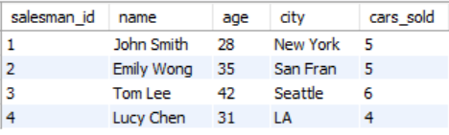
SOLUTIONS
2. What is the total number of cars sold by each salesperson?

Slide 7
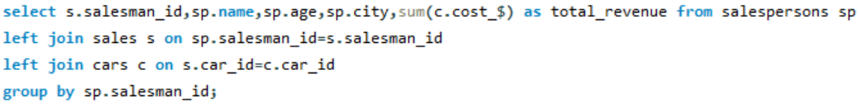
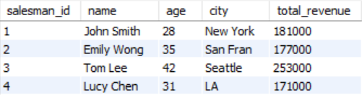
SOLUTIONS
3. What is the total revenue generated by each salesperson?

Slide 8

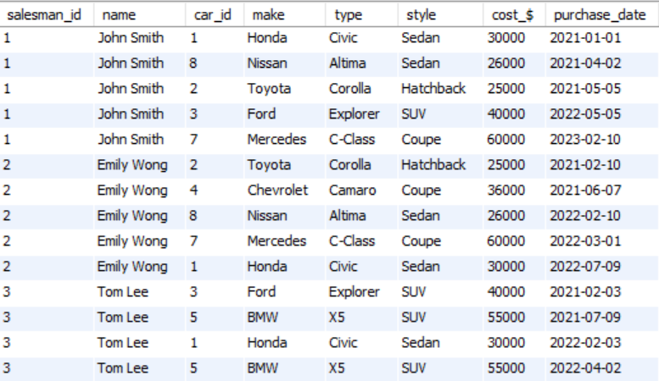
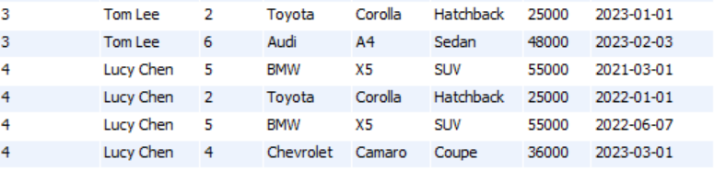
SOLUTIONS
4. What are the details of the cars sold by each salesperson?

Slide 9

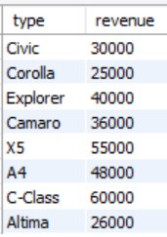
SOLUTIONS
5. What is the total revenue generated by each car type?

Slide 10
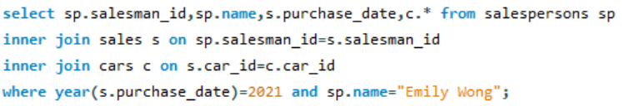

SOLUTIONS
6. What are the details of the cars sold in the year 2021 by salesperson 'Emily Wong'?

Slide 11
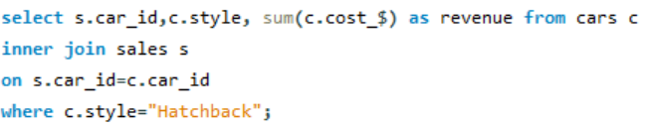

SOLUTIONS
7. What is the total revenue generated by the sales of hatchback cars?

Slide 12


SOLUTIONS
8. What is the total revenue generated by the sales of SUV cars in the year 2022?

Slide 13
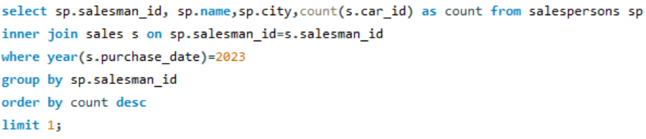

SOLUTIONS
9. What is the name and city of the salesperson who sold the most number of cars in the year 2023?

Slide 14
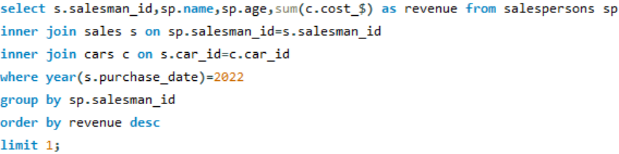

SOLUTIONS
10. What is the name and age of the salesperson who generated the highest revenue in the year 2022?

Slide 15
TERMS USED
SELECT statement
Aggregate Functions (SUM,COUNT)
WHERE clause
Date Function(E.g. Year(Date Column)
GROUP BY
ORDER BY
LIMIT
JOINS

Slide 16
THANK YOU

